Slide 1



Can machines understand the Scientific Literature?
Peter Murray-Rust
University of Cambridge
Open Knowledge Foundation
Vilnius University, 2014-01-24, LT

Slide 2
Themes
Collaboration with COD/IBT
The Semantic Web.
The power and need for Open
Multidisciplinarity
“Artificial Intelligence / Google for Science”
Open, volunteer-based communities

Slide 3
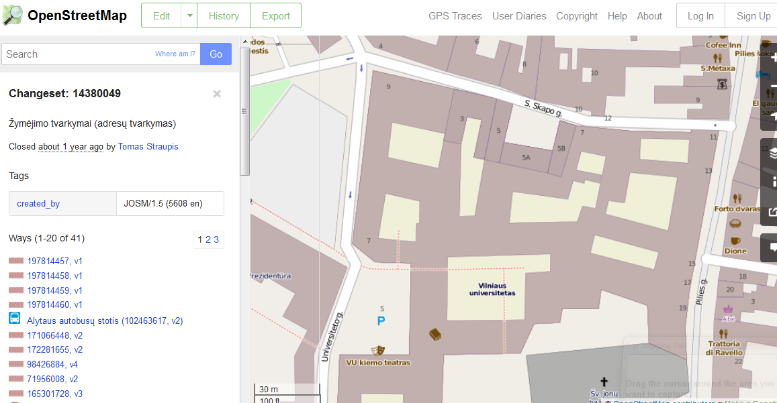
OpenStreetMap
Built by 1 million volunteers; no central funding

Slide 4
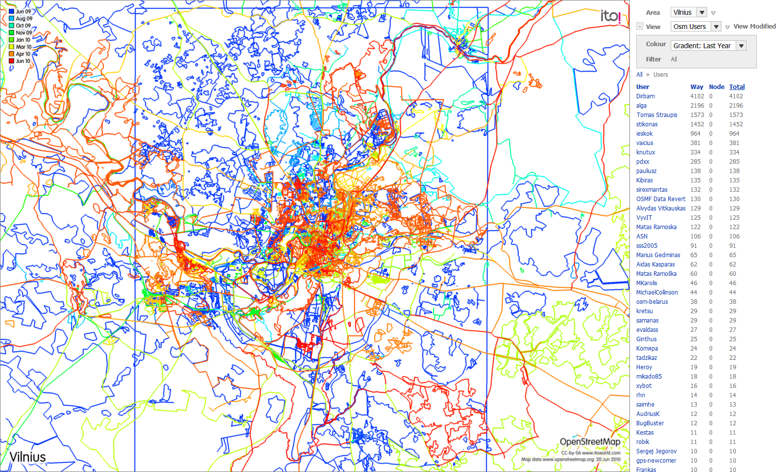
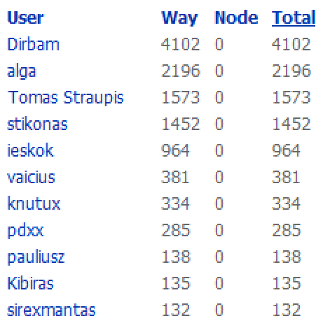
History of OSM mapping Vilnius 2009-10
Users donate GPS traces

Slide 5
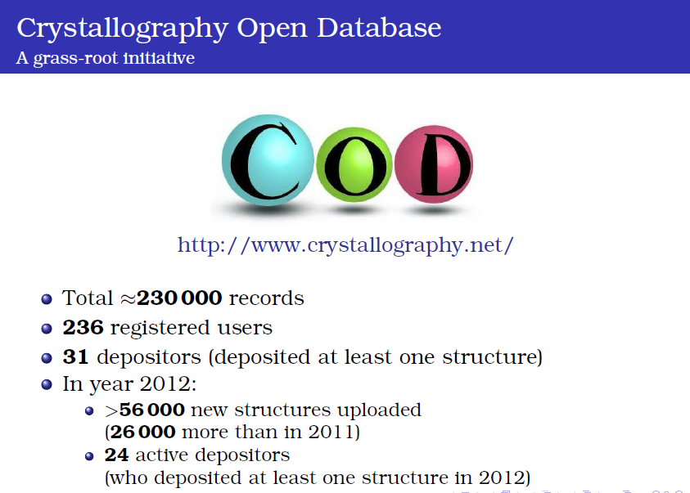
From Saulius Grazulis

Slide 6
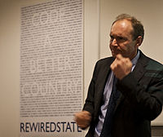
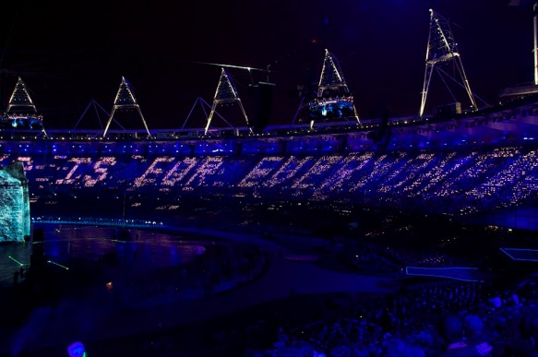
The Semantic Web
"The Semantic Web is an extension of the current web in which information is given well-defined meaning, better enabling computers and people to work in cooperation." Tim Berners-Lee, James Hendler, Ora Lassila, The Semantic Web, Scientific American, May 2001
CC-BY-SA Images from Wikipedia

Slide 7
Artificial Intelligence in science
In 1970 chess and chemistry were the sandboxes for AI. Some approaches:
Lookup (Knowledge)
Natural Language Processing (NLP)
Brute force calculation (inc. physical methods)
Tree-pruning and heuristics
Logic (cf. OWL-DL)
Human-machine integration (crowdsourcing)
Computer Vision
Domain-specific Turing test: Can a machine pass a first-year chemistry exam?

Slide 8
The scientist’s amanuensis
"The bane of my life is doing things I know computers could do for me" (Dan Connolly, W3C)
Example: A semantic amanuensis could
Give me a daily digest of mineralogy papers
Extract all the crystal structures from them
Compute physical properties with GULP and NWChem
Compare the results statistically
Preserve and distribute the complete operation
Prepare the results for publication
The semantic web is having a personal amanuensis

Slide 9

Linked Open Data – the world’s knowledge
RDF
triples
Music,
Art
Literature
Social
DBPedia
Knowledge
bases
Lib
GOV.uk
Comp
PDB
GOV
BIO
Ontologies
very little physical science ☹
http://upload.wikimedia.org/wikipedia/commons/3/34/LOD_Cloud_Diagram_as_of_September_2011.png

Slide 10
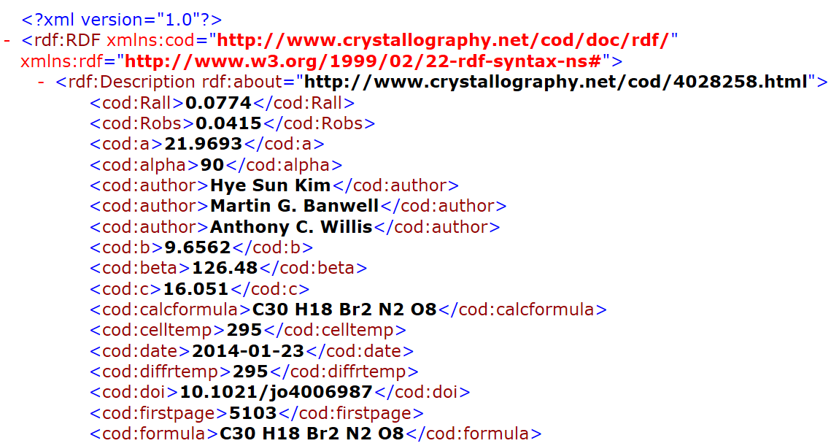
Part of a COD RDF entry
The Semantic Web understands this

Slide 11

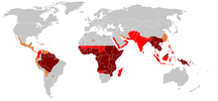
Linked Open data from Wikipedia
“Which Rivers flow into the Rhine and are longer than 50 kilometers?” or “Which Skyscrapers in China have more than 50 floors and have been constructed before the year 2000?”
Open Crystallography?
“Which countries where tropical diseases are endemic have published structures of chiral natural products?”
CC-BY-SA from Wikipedia

Slide 12
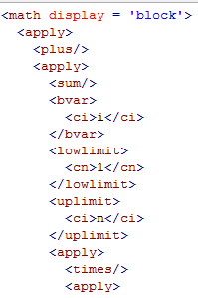
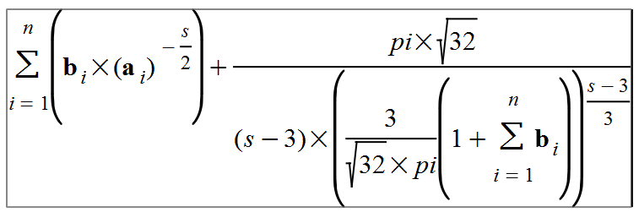
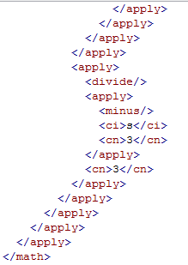
Mathematics Markup Language
MathML
Energy of c.c.p lattice of argon
Automatic!
Human-friendly
4 pages clipped
Many editors and tools exist
We used MathWeaver
Machine-
friendly

Slide 13
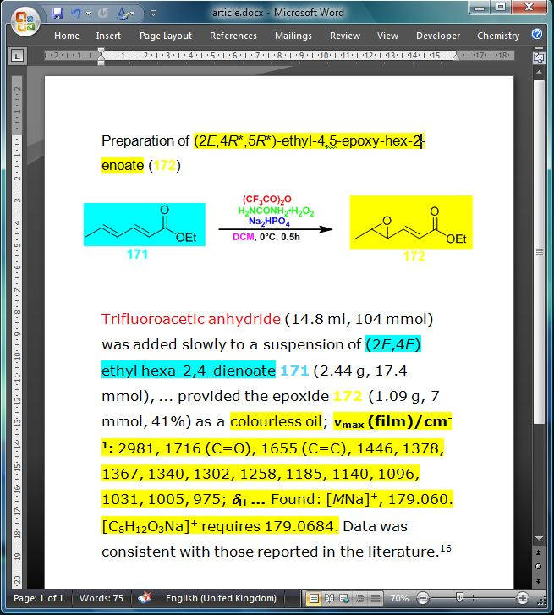
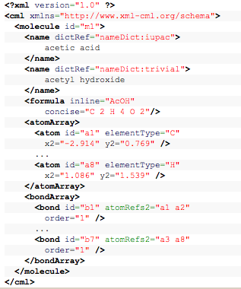
CML (Chemical Markup Language)
Automatic!
Human-friendly
Machine-friendly

Slide 14
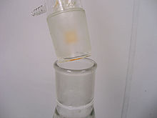
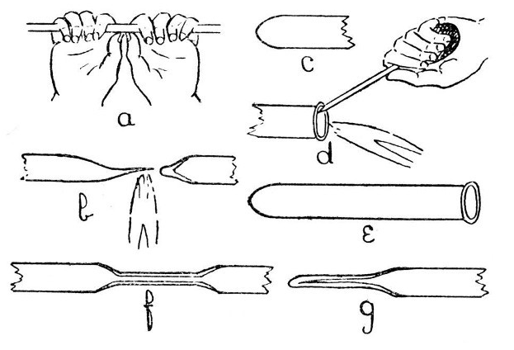
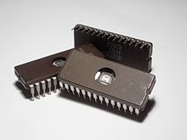
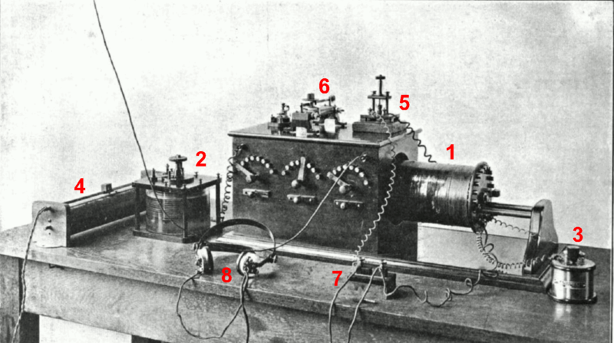
Innovation with Componentisation
Individual, manual, unreusable, flaky
Commodity, standard, reliable, re-usable

Slide 15



Current scientific information flow
… is broken for data-rich science
Non-semantic data
PDF
Lineprinter output
Human input
Text files
Human readers
Data extraction difficult and incomplete

Slide 16




Semantic network closes the loop
Measurement
Computation
Semantic
Authoring
Analysis
Community
Data available for e-science and re-use
Data mined from document

Slide 17


The network grows autonomously
Human-machine
Human-human
Machine-machine
Machine-human

Slide 18
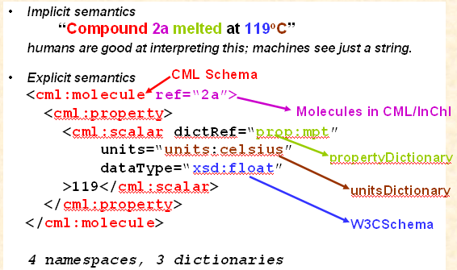
Humans and machines use different languages

Slide 19
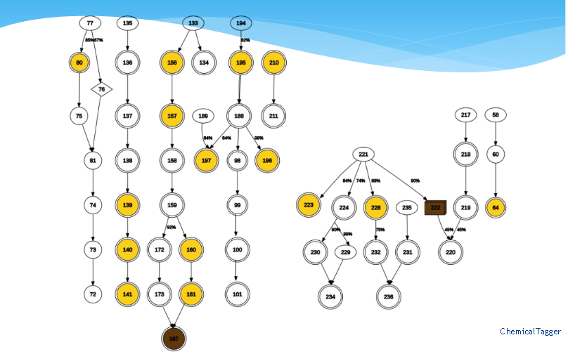
How a machine reads a chemical thesis
nodes are compounds; arrows are reactions

Slide 20
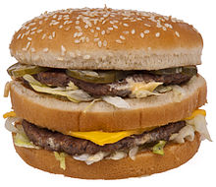
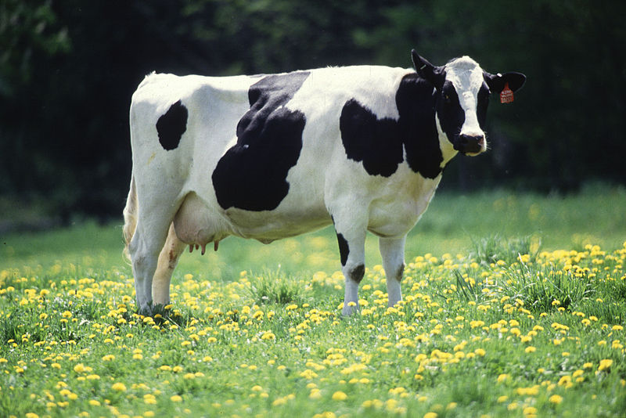
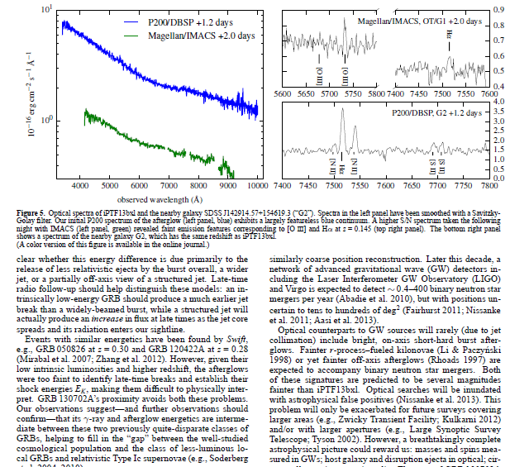
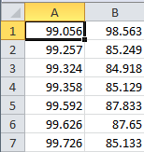
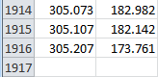
But we can now turn PDFs into Science
We can’t turn a hamburger into a cow

Slide 21
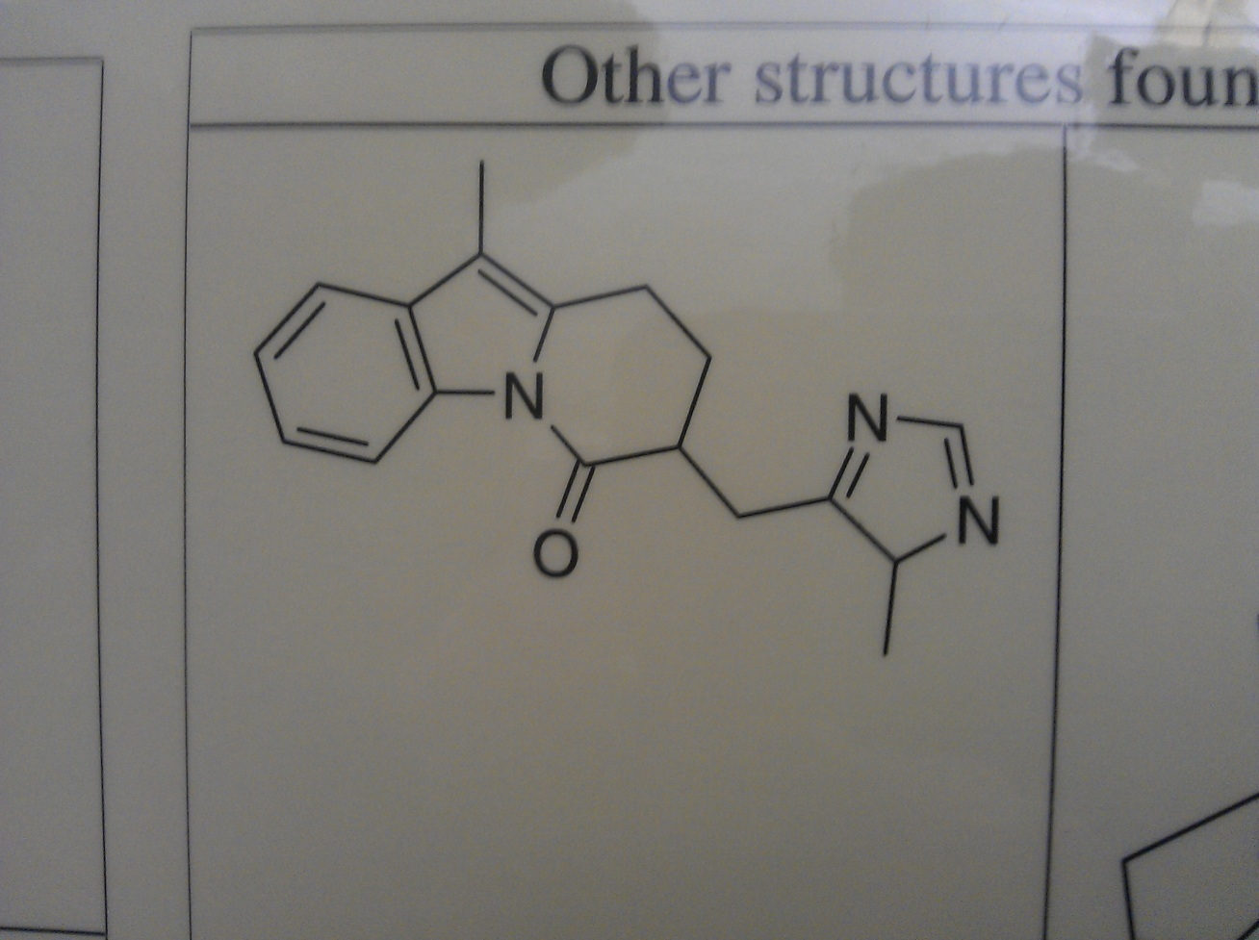
Chemical Computer Vision
Raw Mobile photo; problems:
Shadows, contrast, noise, skew, clipping

Slide 22
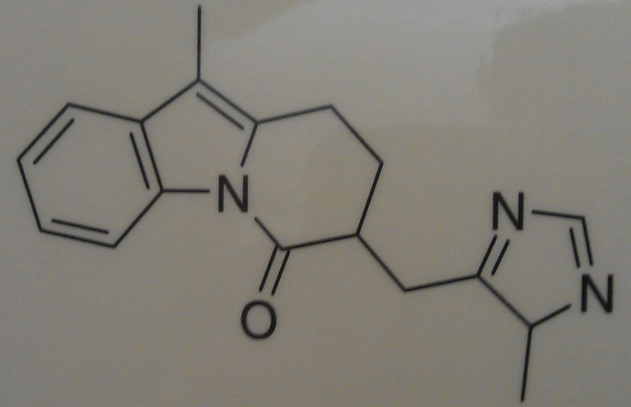
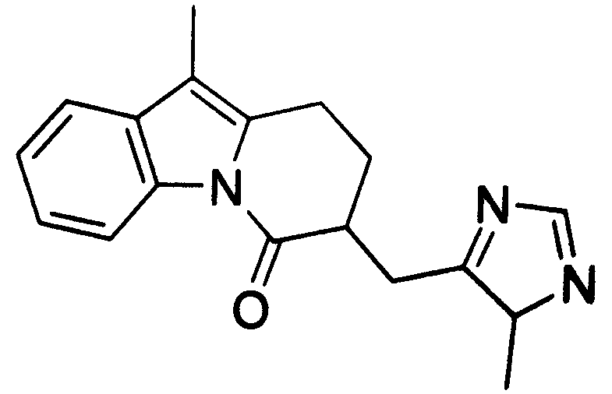
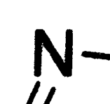
Binarization (pixels = 0,1)
Irregular edges

Slide 23
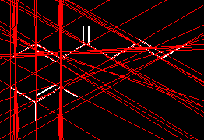
Hough transform for lines
Finds orientation and position (not extent)

Slide 24
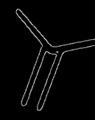
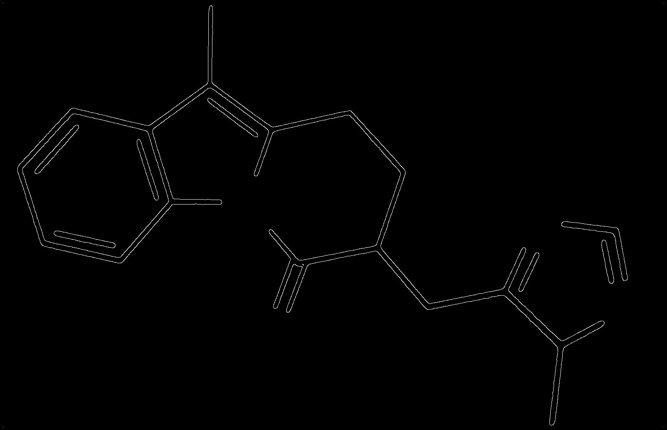
Canny edge detection

Slide 25
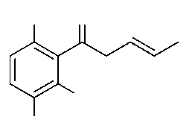
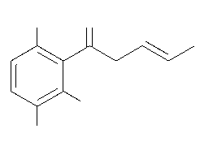
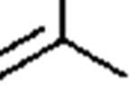
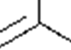
Thinning: thick lines to 1-pixel

Slide 26
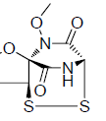
Chemical Optical Character Recognition
Small alphabet, clean typefaces, clear boundaries make this relatively tractable. Problems are “I” “O” etc.

Slide 27
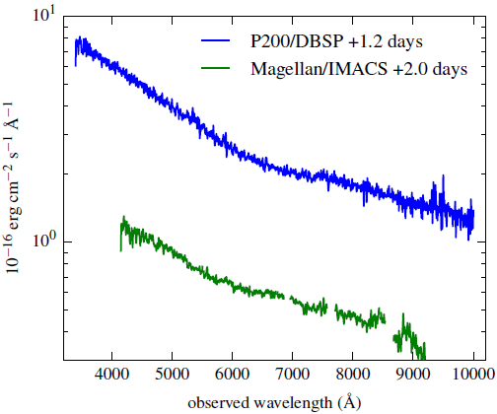
TITLES
DATA!!
2000+ points
UNITS
TICKS
SCALE
QUANTITY

Slide 28
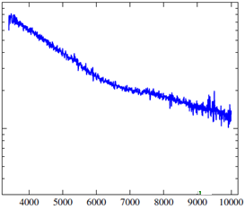
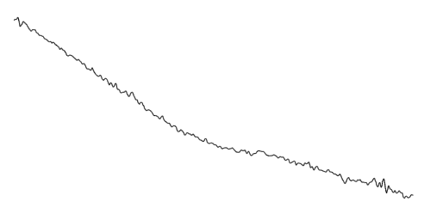
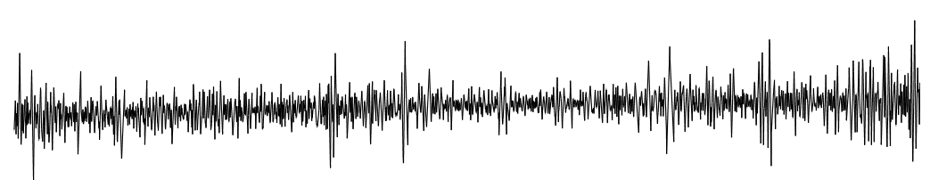
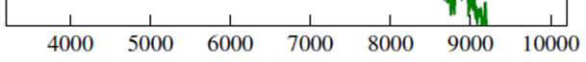
Dumb PDF
Automatic
extraction
CSV
Smoothing Gaussian Filter
Semantic
Spectrum
2nd Derivative

Slide 29
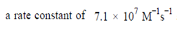
PROPERTIES (Name-Value-Units-Error)
Name
Value
Units
V
U
N
V
U
N
N
V
E
U
N
V
E
U
Note CML supports value ranges and errors

Slide 30
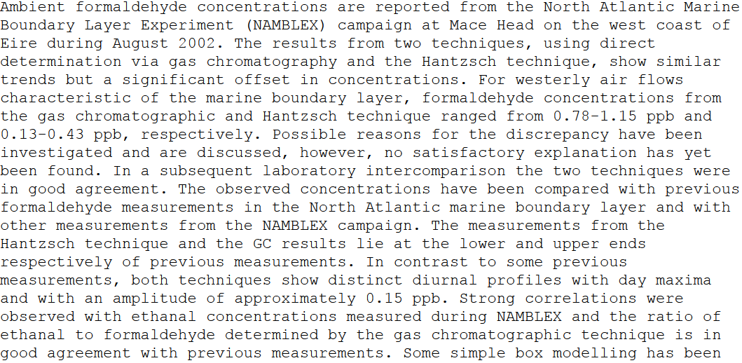
“nuggets” in a scientific paper
places
project
Value ranges
quantity
units
chemical
Humans aren’t designed to mine this … ☹

Slide 31
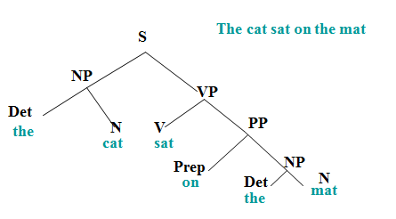
Natural Language Processing
Part of speech tagging (Wordnet, Brown Corpus, etc.)

Slide 32
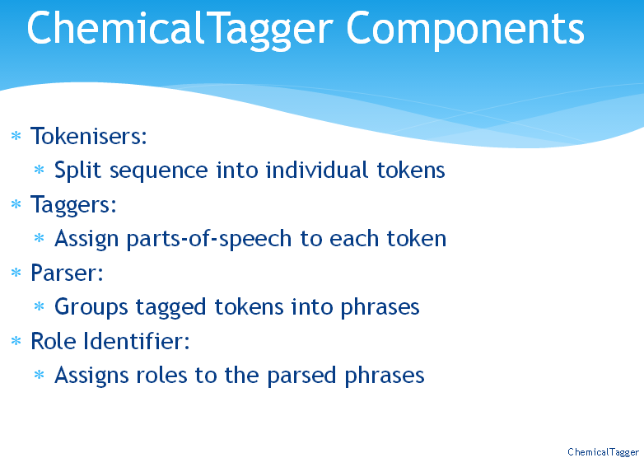

Slide 33
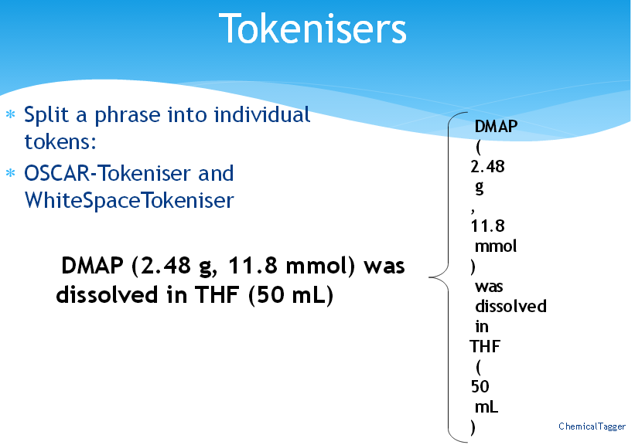

Slide 34
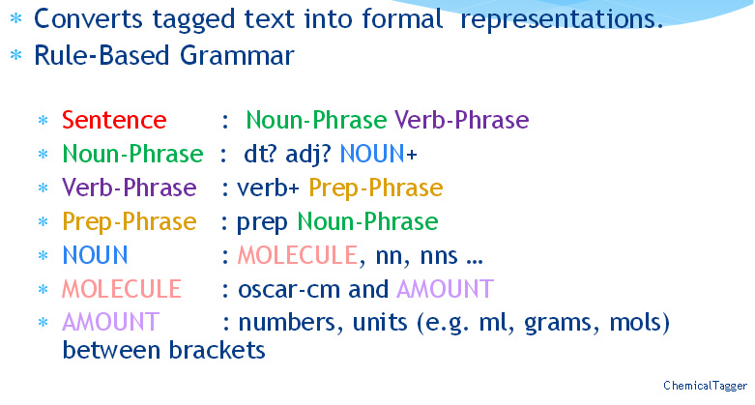
Chemical NLP components

Slide 35
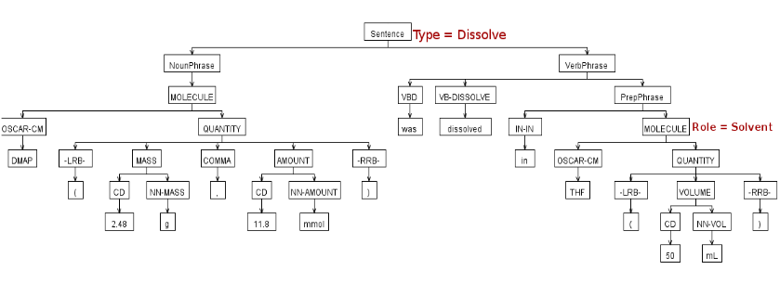
Parsing chemical sentences

Slide 36
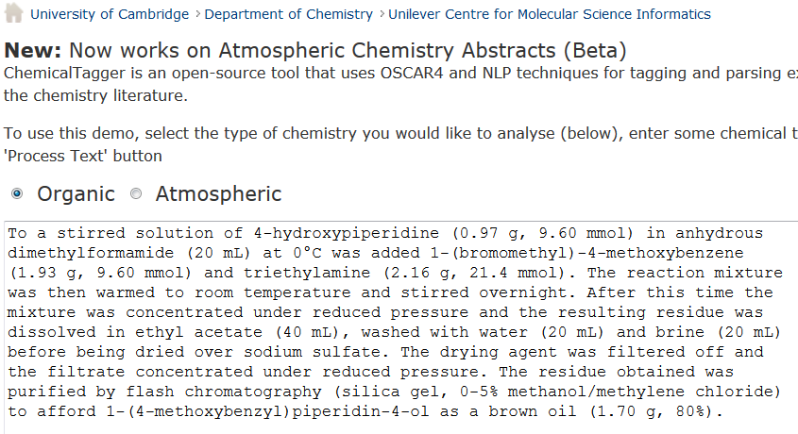
http://wwmm.ch.cam.ac.uk/chemicaltagger
Typical
Typical chemical synthesis

Slide 37
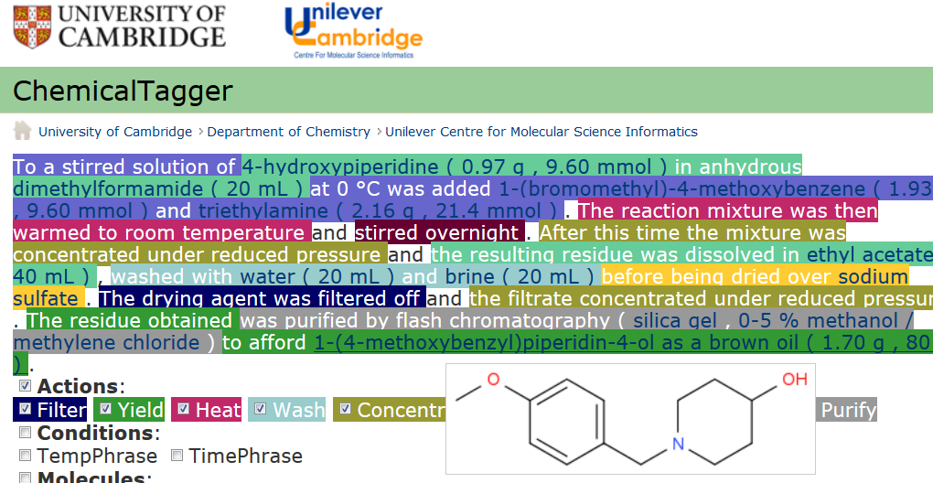
Automatic semantic markup of chemistry
Could be used for analytical, crystallization, etc.

Slide 38


Open Content Mining of FACTs
Machines can interpret chemical reactions
We have done 500,000 patents. There are > 3,000,000 reactions/year. Added value > 1B Eur.

Slide 39

Mathematics
CML is being integrated with computable (content) MathML

Slide 40

PDF ☹
AMI
HTML ☺
Evolution of ultraviolet vision in the largest avian radiation - the passerines
Anders Ödeen ^{1*} , Olle Håstad ^{2,3} and Per Alström ⁴
Styles , ^{superscripts}
And diåcritics
preserved!

Slide 41

PDF ☹
Turdus iliacus
Taeniopygia guttata
Serinus canaria
Lanius excubitor
Melopsittacus undulatus
Pavo cristatus
Sturnus vulgaris
Dolichonyx oryzivorus
Ficedula hypoleuca
Vaccinium myrtillus
Falco tinnunculus
Turdus
Pomatostomus
Leothrix
Amytornis
Acanthisitta
Orthonyx x 2
Malurus
Cnemophilus x 4
Philesturnus x 2
Motacilla x 2
Toxorhampus x 2

Slide 42



Typical phylo tree: 60 nodes, complex and miniscule annotation,
vertical text, hyphenation and valuable branch lengths. AMI extracts ALL

Slide 43

AMI
Acanthisittidae
Acanthizidae
Acrocephalidae
Callaeidae
Campephagidae
Cnemophilidae
Corvidae
Acanthisitta
Acrocephalus
Ailuroedus
Ailuroedus
Amytornis
Camptostoma
0.84
0.91
0.93
0.95
23.12
34.54
37.21
38.55
NexML
HTML
Posterior
probability
AMI can MEASURE
Branch lengths!
Genus
Family

Slide 44

Supplemental Information (CIFs) harvested
from Publications
ACS
IUCr
RSC
ELS

Slide 45

As-Cl Bond lengths
Short
Long

Slide 46

Long

Slide 47

Short

Slide 48

Link to Journal

Slide 49

The Blue Obelisk – Open Chemistry
 | Open Data, Open Standards, Open Source consistent and complementary non-divisive and fun CDK JChempaint Jmol JOELib JUMBO NMRShiftDB Octet Openbabel QSAR WWMM JSpecView http://www.blueobelisk.org

Slide 50

Blue Obelisk 2005-03-13

Slide 51
Recommendations for Open Crystallography
Require Open Crystal Data for all publications
Deposition of Open Data in COD
Integrate CIF dictionaries as RDF into Linked Open Data
Integrate COD into Linked Open Data Cloud
CCDC/ICSD to publish RAW author CIFs Openly

Slide 52
http://upload.wikimedia.org/wikipedia/commons/3/34/LOD_Cloud_Diagram_as_of_September_2011.png
CIFDIC
COD

Slide 53
The network grows autonomously
Human-machine
Human-human
Machine-machine
Machine-human

Slide 54
TimBerners-Lee’s Open data http://5stardata.info
★ | make your stuff available on the Web (whatever format) under an OPEN license
★★ | make it available as structured data (i.e. NOT PDF)
★★★ | use non-proprietary formats (e.g., CSV)
★★★★ | use URIs to denote things, so that people can point at your stuff
★★★★★ | link your data to other data to provide context
CIFDIC
ACS
IUCr
CRYSTALEYE

Slide 55

statement "Nitrazepam" "target" "Gamma-aminobutyric-acid receptor subunit alpha-1"
triple:
drugbank:DB01595 // compound drugbank_vocabulary:target // predicate
drugbank:872 . // target
“Compound hasTarget Target”

Slide 56
Some statistics
3,000,000 scholpubs/year => 10,000 / day
~~ $1000 APC / pub, typesetting $10 per page,
Subscriptions ~ $10,000,000,000 / year
20% ?? of current pubs Open or accessible
Article ~ 1MByte, 15 pp (w/o data, images)
Download and processing ca 1 sec/page
arXiv $7 per article.

Slide 57

RCUK
Wellcome
ERC
NSF …
require
fully OPEN
[at Research Data Alliance, we are entering a new “era of open science”, which will be “good for citizens, good for scientists and good for society”.
She explicitly highlighted the transformative potential of open access, open data, open software and open educational resources – mentioning the EU’s policy requiring open access to all publications and data resulting from EU funded research.
http://blog.okfn.org/2013/03/21/we-are-entering-an-era-of-open-science-says-eu-vp-neelie-kroes/#sthash.3SWDXDE6.dpuf

Slide 58

Open Definition
“A piece of data or content is open if anyone is free to use, reuse, and redistribute it — subject only, at most, to the requirement to attribute and/or share-alike.”
OPEN | NOT OPEN
PDB COD,Crystaleye | CCDC, ICSD
RSC/ACS/IUCr CIFs | Elsevier/Wiley/Springer CIFs
Acta Cryst E | Acta Cryst ABCD (default)
CIF dictionaries

Slide 59

Panton Principles for Open Data in Science
Why? Wanted to avoid the mess in OA
Peter Murray-Rust, Cameron Neylon, Rufus Pollock, John Wilbanks
2008-> 2010 (launch) at
Panton Arms
Panton Fellowships (2012)
Launch 2010
Jordan
Hatcher
John
Wilbanks
Peter
Murray-Rust
Jenny
Molloy
Rufus
Pollock
Cameron
Neylon
“Licence STM Data as CC0”

Slide 60
ContentMining Targets
PLOS, BMC (species/phylo): Ross Mounce (Bath)
MDPI (metabolism, molecules):
AndyHowlett, MarkWilliamson (Cambridge)
Crystallography (PMR, COD)
In 2014-04 ALL papers are minable in UK:
Species/phylogenetics (ca 10,000 /year)
Crystallographic recipes
Metabolism

Slide 61

Hackathons

Slide 62
Large-scale Mining
CRAWLING
SEMANTICS
PDF
XML
HTML
SVG
PNG
DOCX, XLS
CSV, CIF
Raw content
AMI
Publisher-Specific
Crawler
Publisher
Site
Metadata
Science
Scientific Search Indexes
Current/Daily awareness
Mashups/LOD
New data
Validation / reproducibility
Reformatting
Semantic Objects
CKAN
BackingStore
GoogleAPI?,
AWS?
USE
STORAGE

Slide 63
Benefits of ContentMining
Liberation of fulltext data.
Liberation of supplemental data (PDF, DOCx)
Normalization of syntax and vocabulary
Integration with Open resources (Wikip/media), Pubchem, ChEBI, ChEMBL
Open non-proprietary search indexes
Validation (self-consistency, against standards, computability, fraud)

Slide 64


10 million spectra published /year

Slide 65


Slide 66


Slide 67
Review of the NMR data reported in the Supporting Information in this article evidences instances where some of the spectra were inappropriately edited to remove impurities. A coauthor and former student, Dr. Bruno Anxionnat, has shared with me formal communication in which he states “I would like to take full responsibility for this entire situation. I was in charge of making the SI of my papers and I erased some peaks without telling anybody. All my supervisors (Pr. Cossy, Dr. Gomez Pardo and Dr. Ricci) trusted me and I wasn't dependable. I am the only one who has to be blamed for all that, in any case them. I know my behavior is highly unethical. I am deeply sorry for what I have done and for hurting people….”

Slide 68
Some thanks
Jenny Molloy (Oxford), Max Hauessler (UCSD)
Joe Townsend, Nick Day, Jim Downing, Mark Williamson, Peter Corbett, Daniel Lowe and others UCC Cambridge.
Ross Mounce (Bath)
Saulius Grazulis (COD)

Slide 69
Take-away messages
Lost/unused STM* data costs 30-100Billion /yr [1]
Licence: DATA as CCZero and TEXT as CC-BY
Content Mining for DATA is a RIGHT
Apathy is our worst enemy
Trust and empower young people
“A piece of content or data is open if anyone is free to use, reuse, and redistribute it — subject only, at most, to the requirement to attribute and/or share-alike.”
*Scientific Technical Medical
[1] PMR: submission to UK Hargreaves process

